Slide 1
Classification of Moscow Metro Station

Slide 2
Datasets
Moscow Metro station data from wikepedia
Foursquare Data

Slide 3
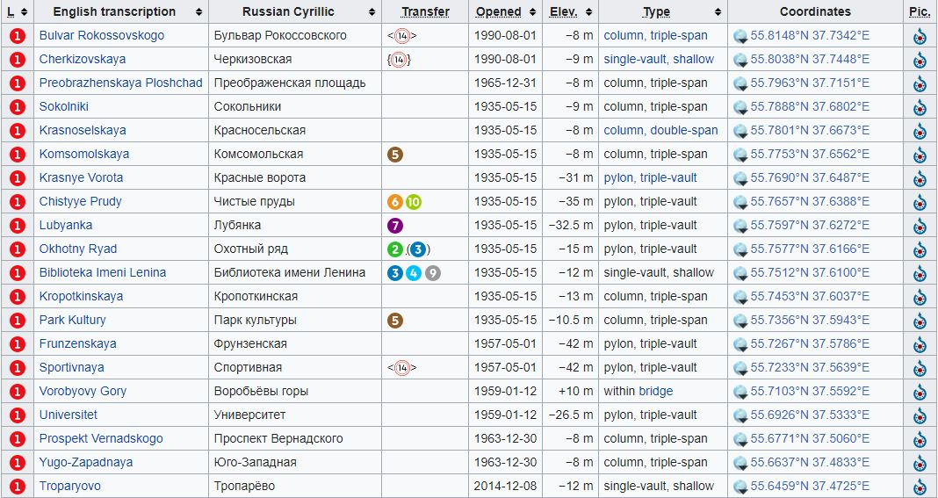
Datasets
Moscow Metro Data

Slide 4
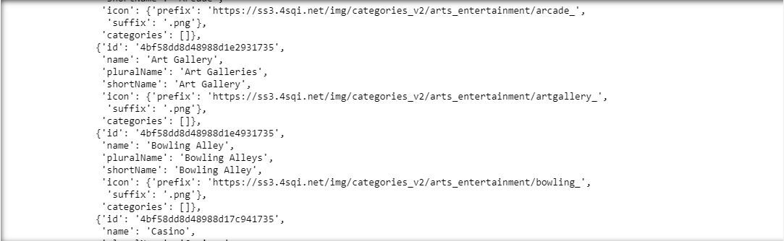
Datasets
Foursquare Data

Slide 5
Venues Categories
Arts & Entertainment,
College & University,
Event,
Food,
Nightlife Spot,
Outdoors & Recreation,
Professional & Other Places
Residence
Shop & Service
Travel & Transport

Slide 6
Methodology
We start with scraping Wikipedia page and collect Moscow metro station data. And remove unnecessary data.
Using Foursquare API, I have fetch query of categories of venues. There are main ten types of categories. They are main types of categories. All ten categories contain sub categories.

Slide 7
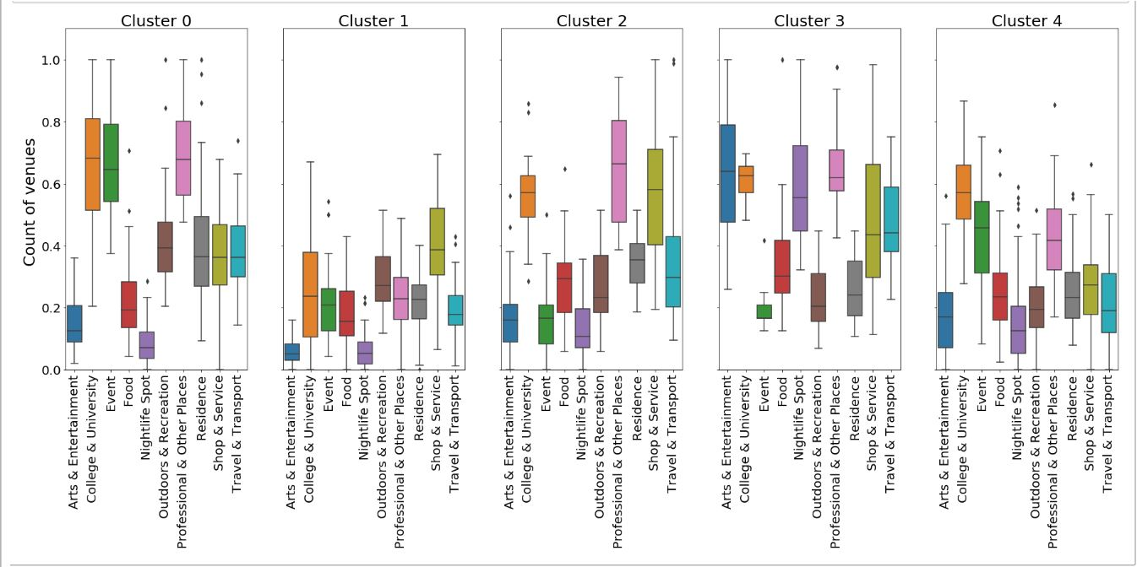
Results

Slide 8
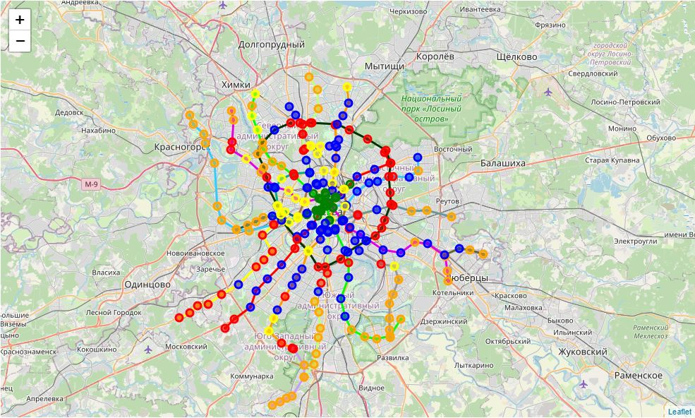
Map Reperesentation

Slide 9
The END

